Slide 1
TEAM UFO
ISTE 612: Information Retrieval and Text Mining
…Exploring the World Of
Declassified Government Documents…
Cory Maclauchlan, John Myers, Arivirku Thirugnanam

Slide 2
Agenda
01
02
03
04
The problem
The data
Why we developed this software
How we preprocessed and represented the data
MODELS used
results
Indexing and clustering techniques used
What we observed about the techniques
2

Slide 3
The Problem
Periodically, the US Government releases to the public large troves of declassified documents that have been requested.
These documents are all related to the same topic, but vary greatly in what information they provide.
We endeavored to research if there was a way to pore through these documents in a better way to understand them more quickly.
3

Slide 4
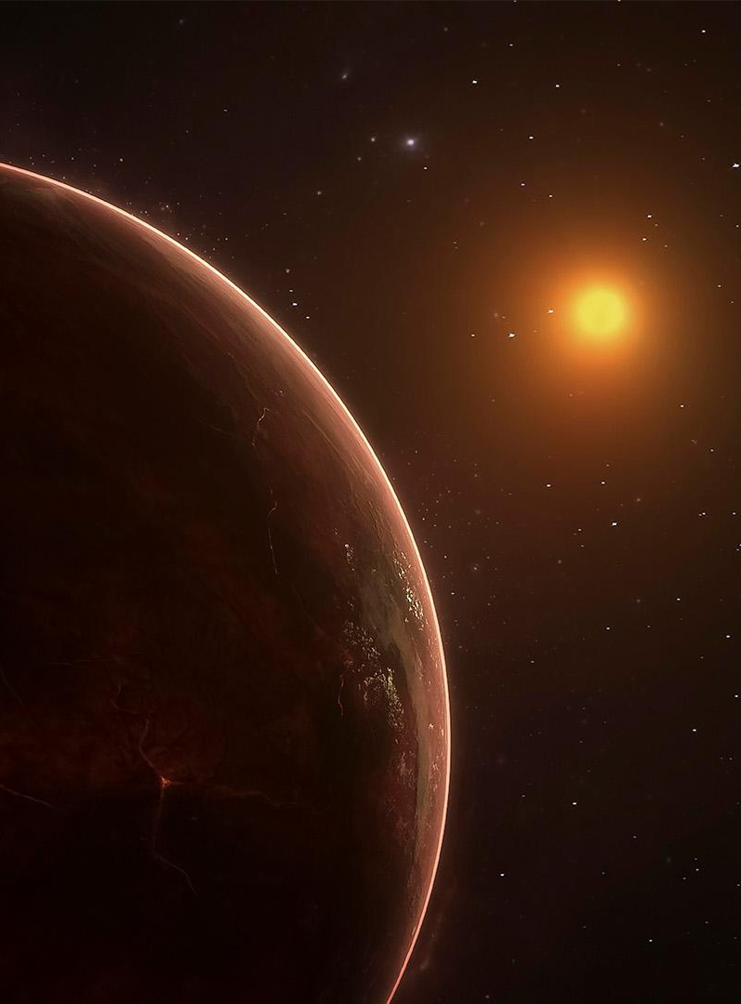
Why develop this for this use case?
The CIA released a large cache of documents in 2021 related to UFOs to “The Black Vault” upon a Freedom of Information Act (FOIA) request.
The document collection consists of a mixture of scans of printed materials with redactions, memo posts and high-quality documents.
The documents are released without labeling or categorization of any kind.
Owing to data quality, classifying or extracting any useful information from the documents would be a tedious process to perform manually and without aid.
4

Slide 5

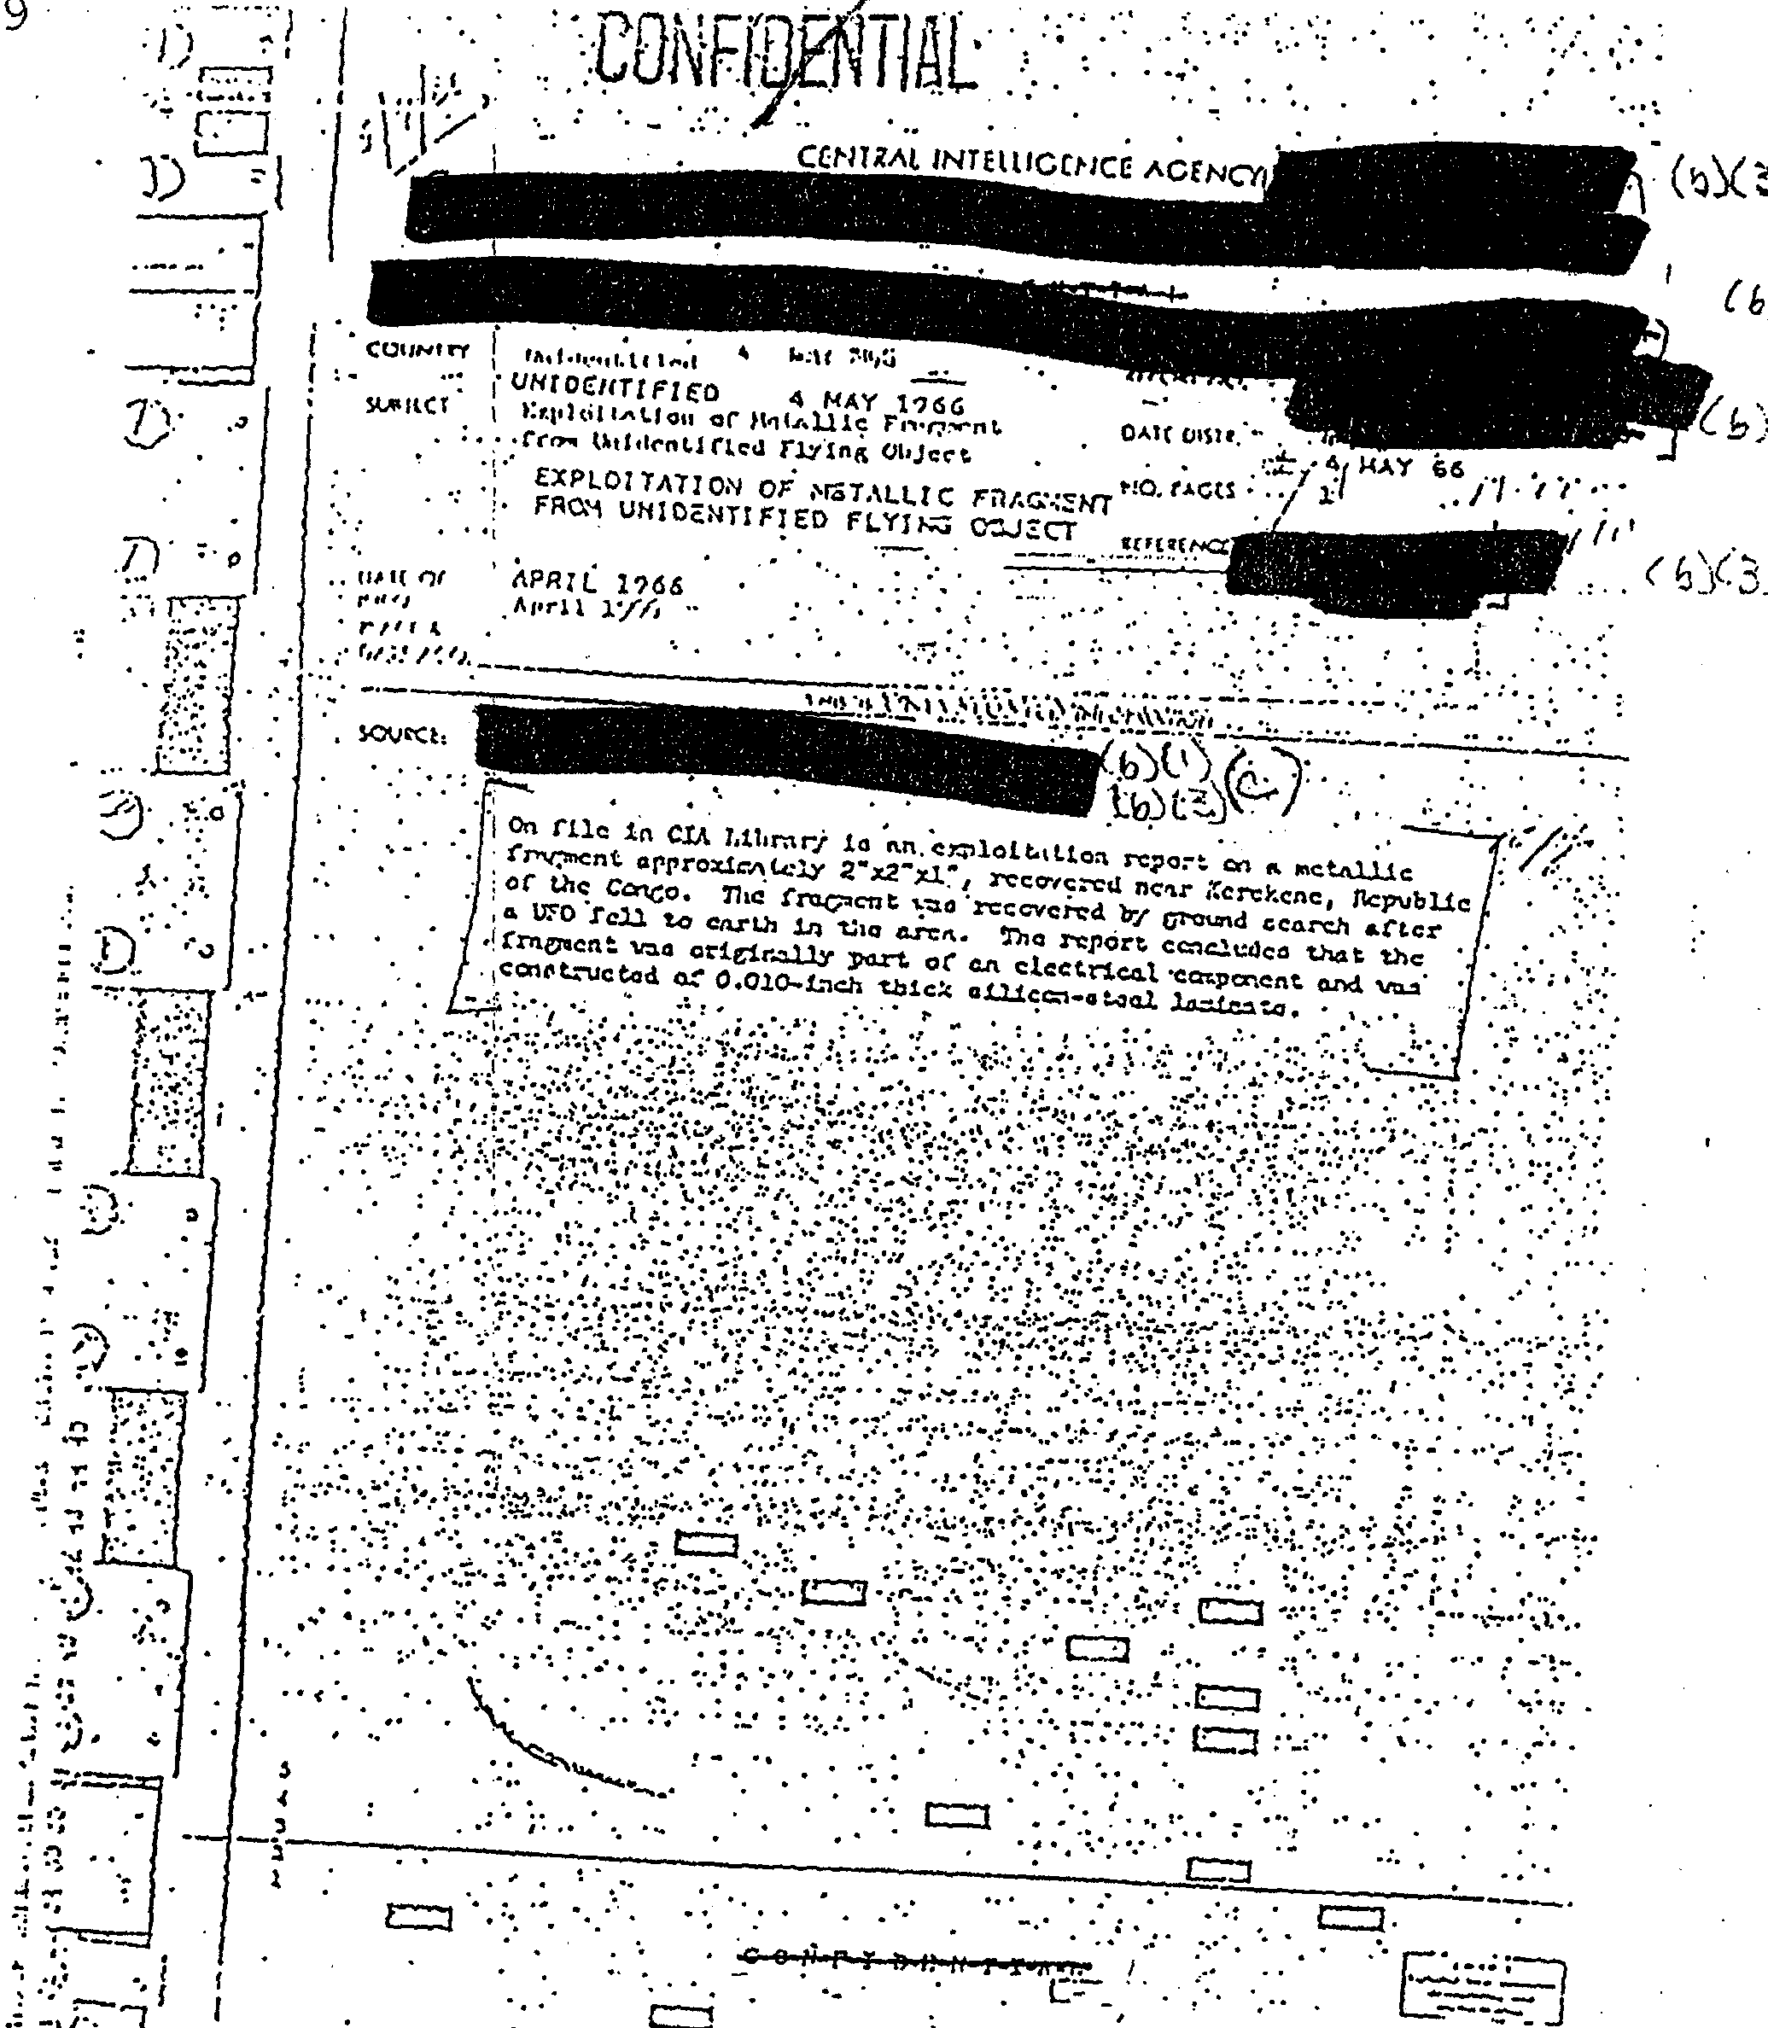
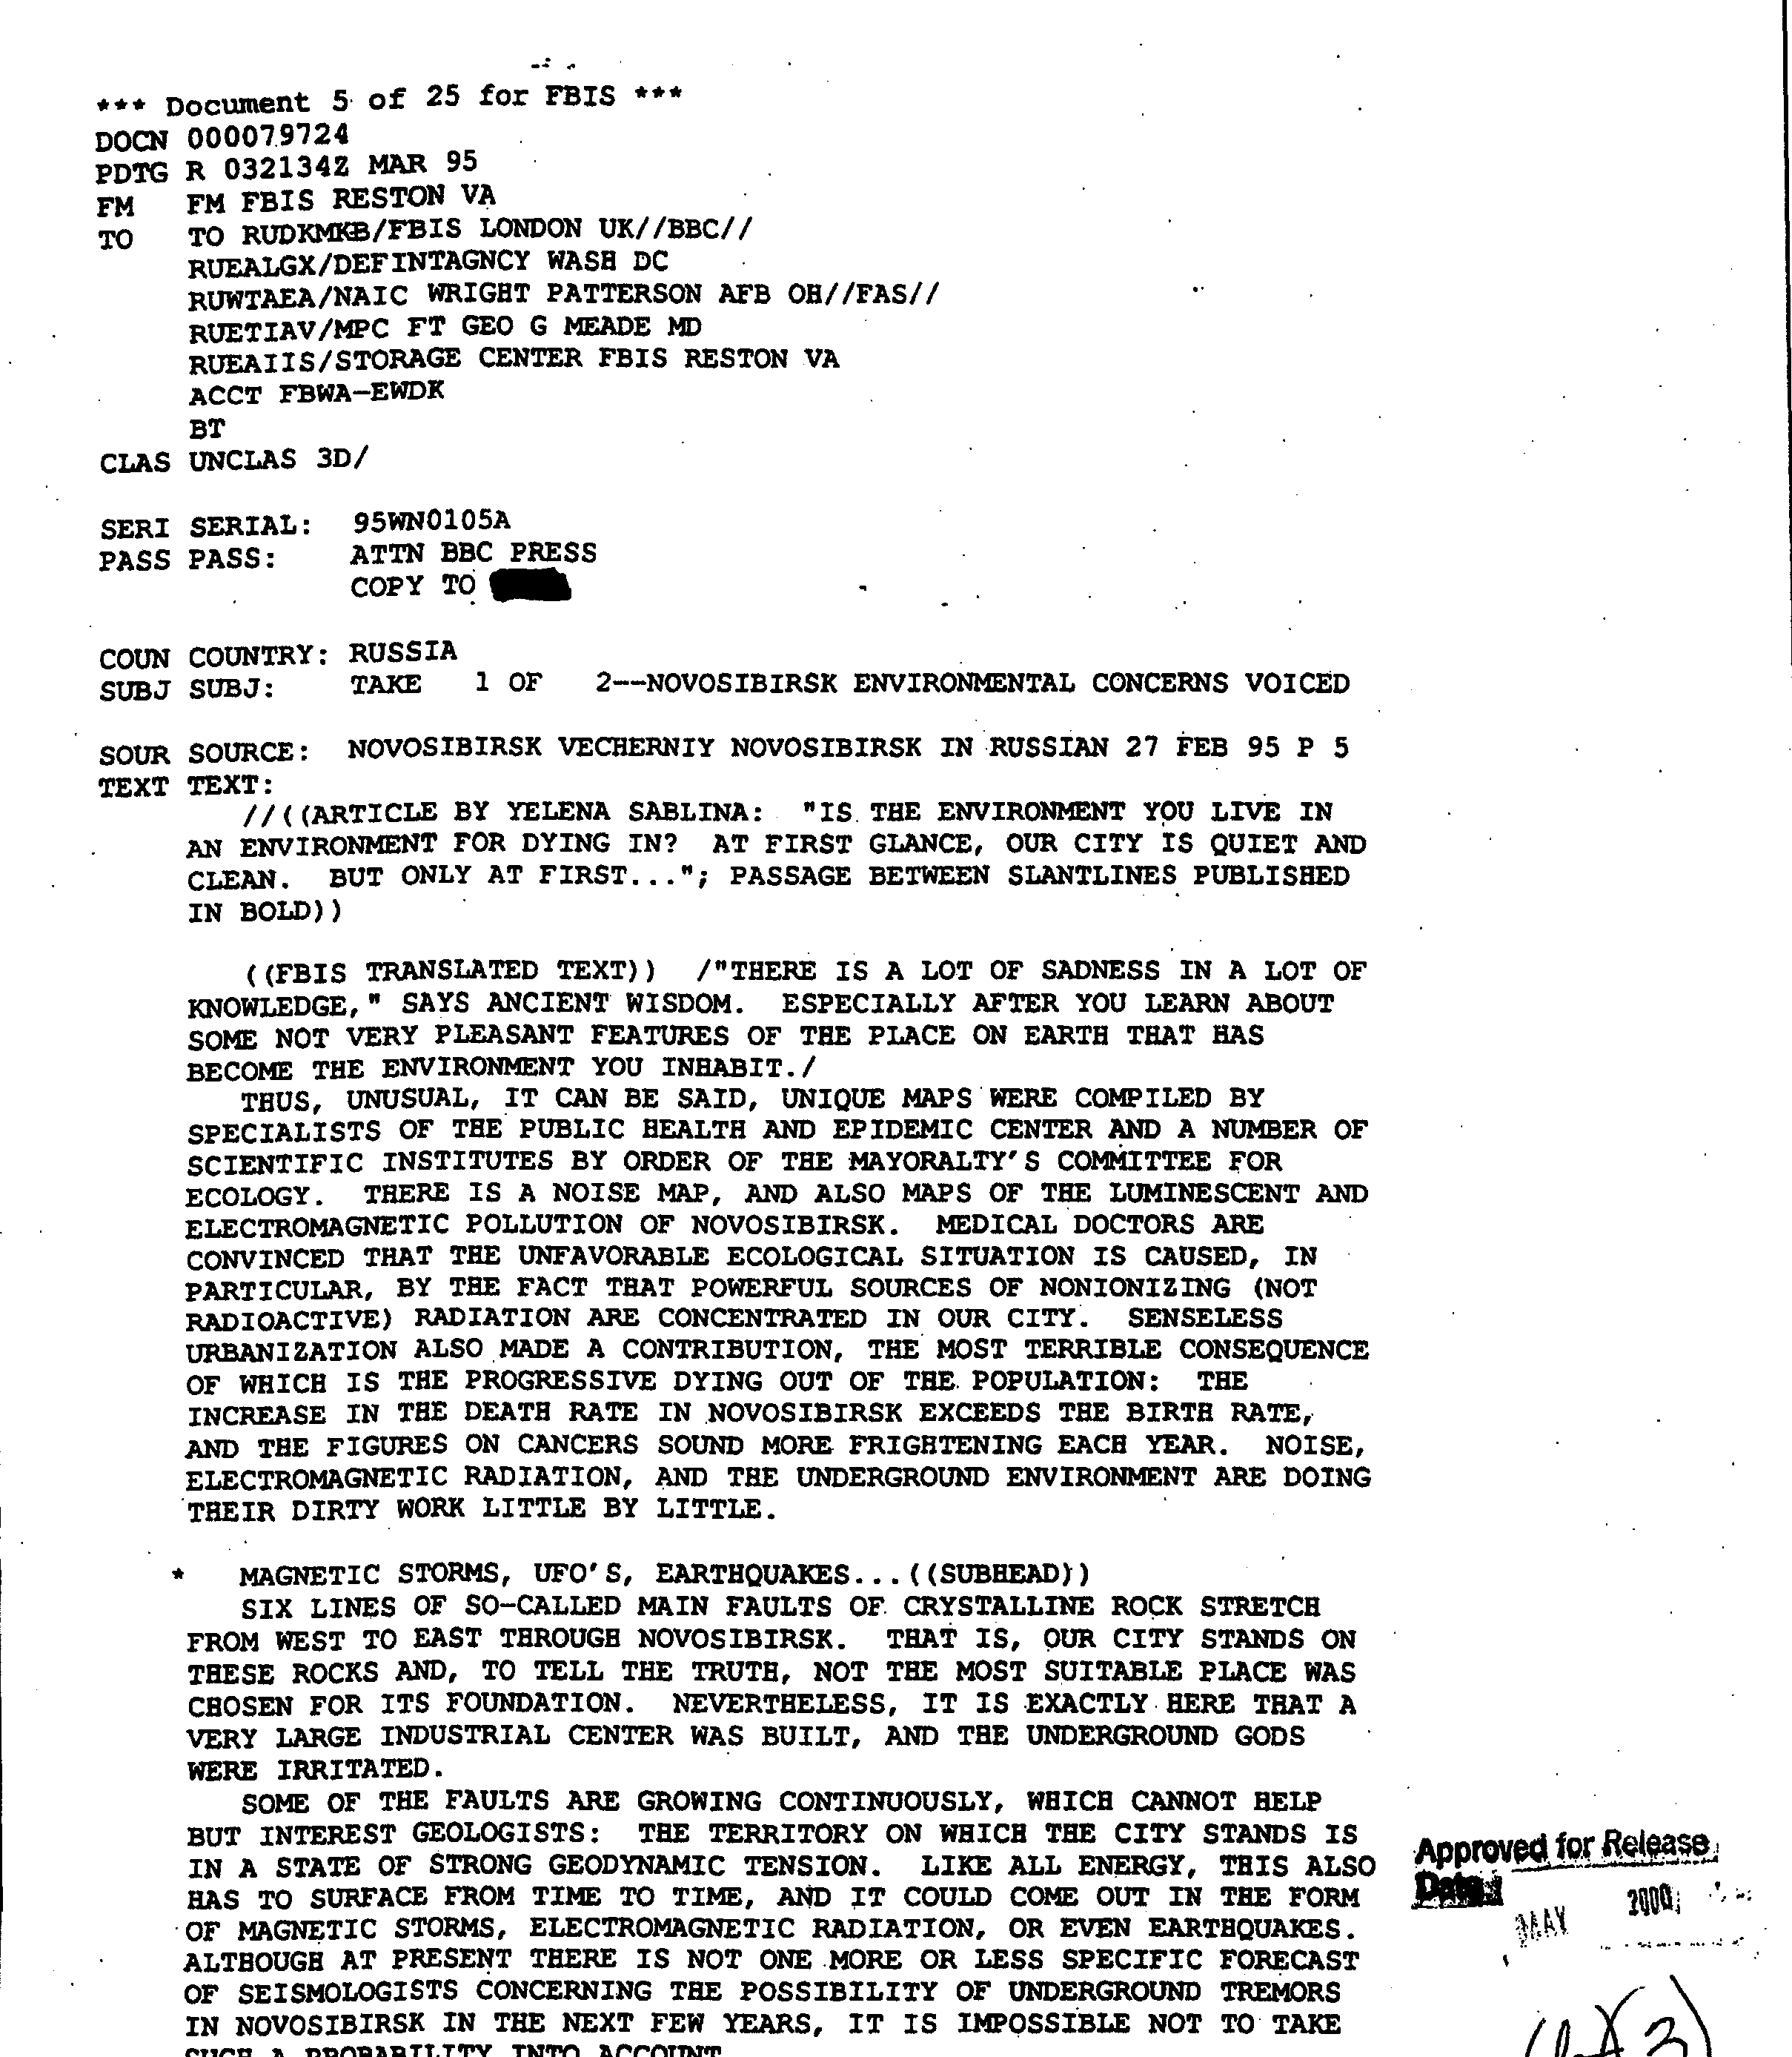
The Data
Low quality
High quality
A total of 712 PDF documents, containing 3493 pages of text related to UFOs were created from TIFF images from the CIA.
5

Slide 6
Data Preprocessing and representation
To analyze the documents, we needed to extract as much text as possible from the produced PDF documents.
We compared the extracted text from pypdf2 and pdfminer and found out that pdfminer has better efficiency and extracted more complete words.
Each PDF document is opened, the text is extracted using pdfminer, tokenized, and imported into memory.
All tokenized words are compared to a Wordnet, and only words with semantics are indexed (ie, we only use actual words in our analysis).
Only documents that have at least three words are used in this analysis.
6

Slide 7
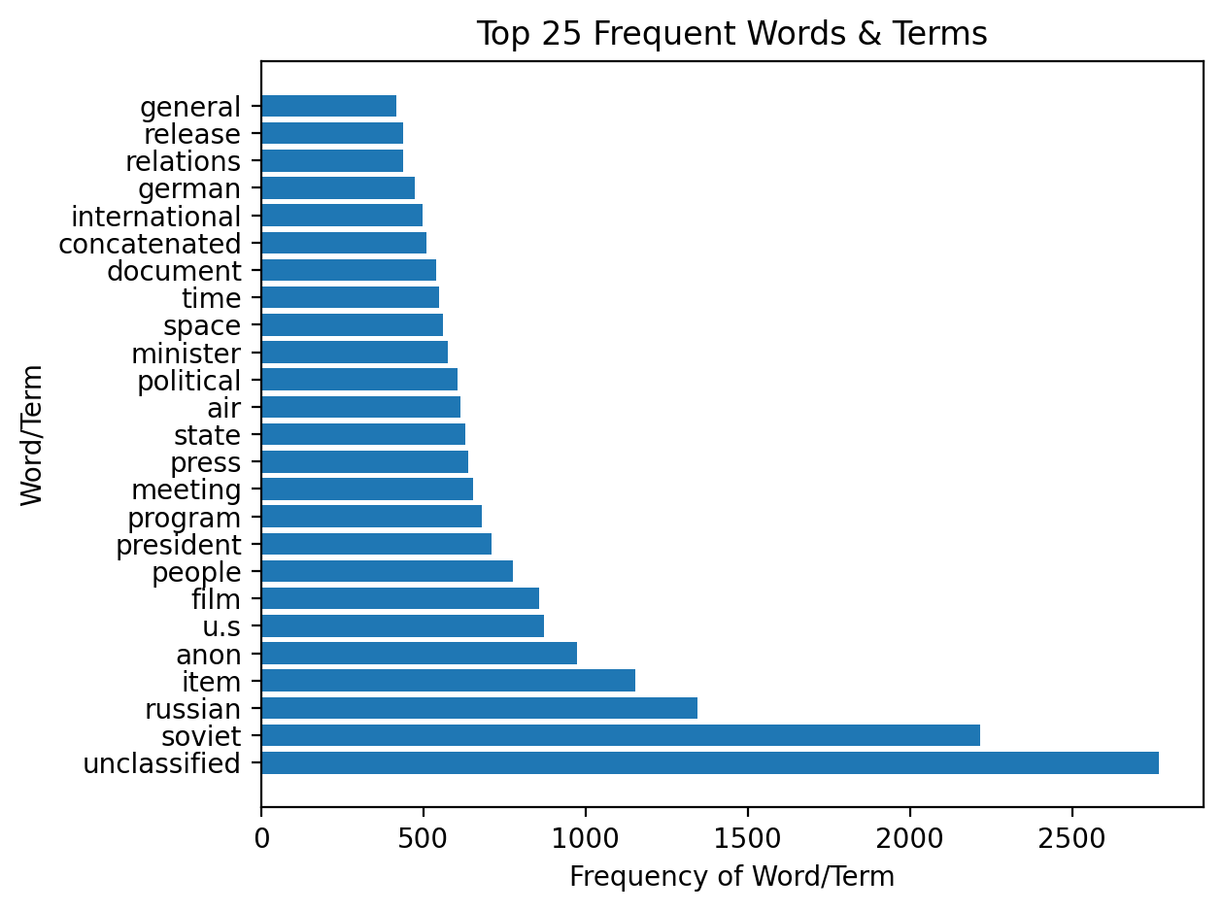
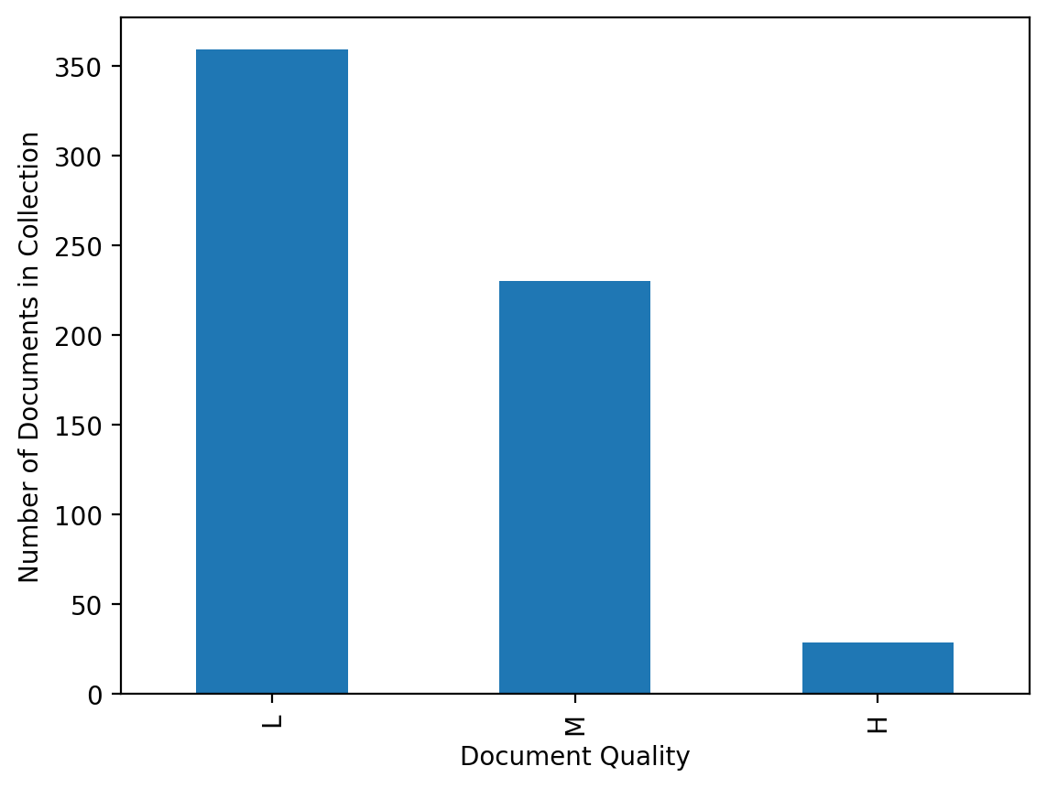
Document set Attributes
Low Quality: 359, Medium Quality: 230, High Quality: 29
In our implementation, 144 MB of PDFs take just under five minutes to upload, parse, tokenize, categorize, and index.
There are 8205 words in the resulting dictionary.
A total of 96 documents have no useful information within them.
7

Slide 8

Information Retrieval and LEARNING Models Used
K-Means
Vector Space Model
A Vector Space Model (VSM) is established to position documents and assign a score to matching query results and rank them, using the product of term frequency and inverted document frequency (tf-idf). This scoring system assigns a higher weight to less common words, preventing words common across all documents from skewing the results.
Within the vector space, Cosine similarity is used to determine closeness between documents. This helps to reduce the impact of document size in determining closeness.
Combined, all of this allows the IR system to return the most relevant matches first.
K-Means Limitations
The K-means Clustering algorithm is an unsupervised learning method that requires lots of fine-tuning and one should keep in mind its limitations and drawbacks:
It doesn’t work well with small size datasets.
It doesn’t perform well on datasets with a uniform distribution.
An optimal K-value must be selected and implemented by the user.
8

Slide 9
RESULTS!
Here is what we observed in our exploration of this large cache of UFO documents…
9

Slide 10
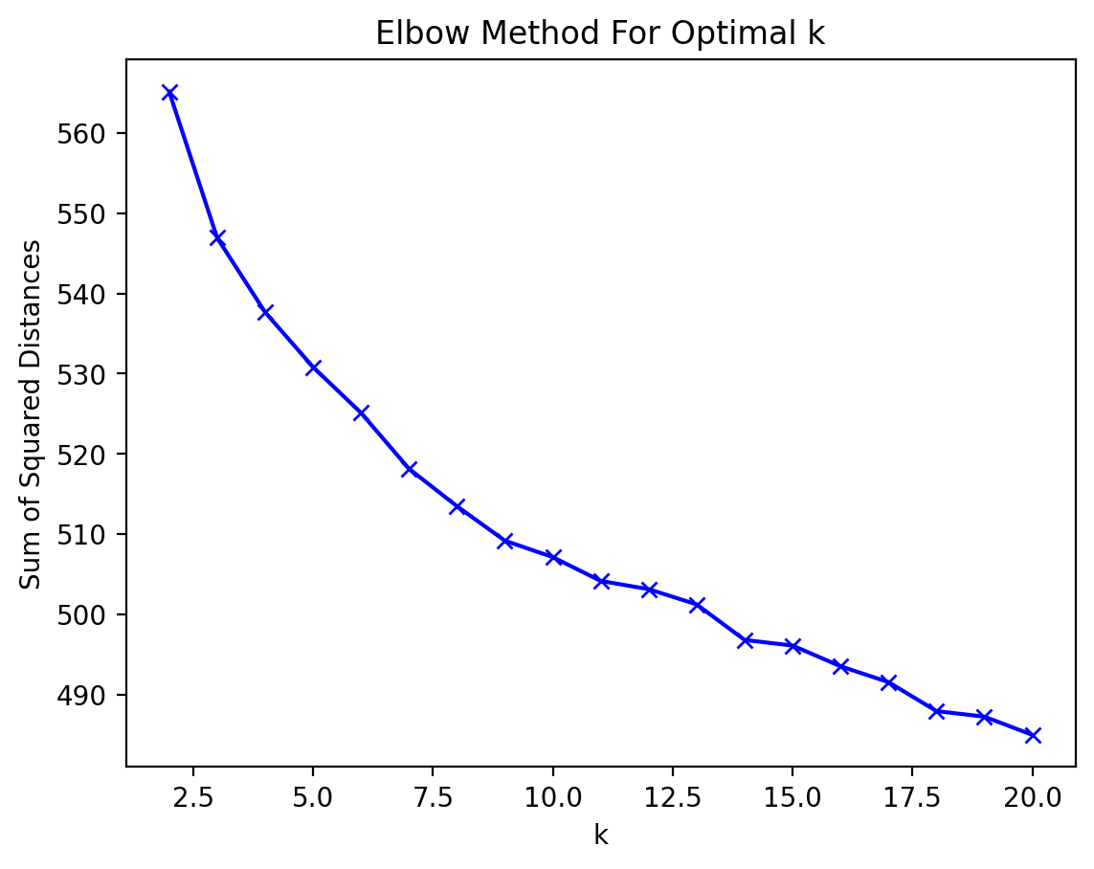
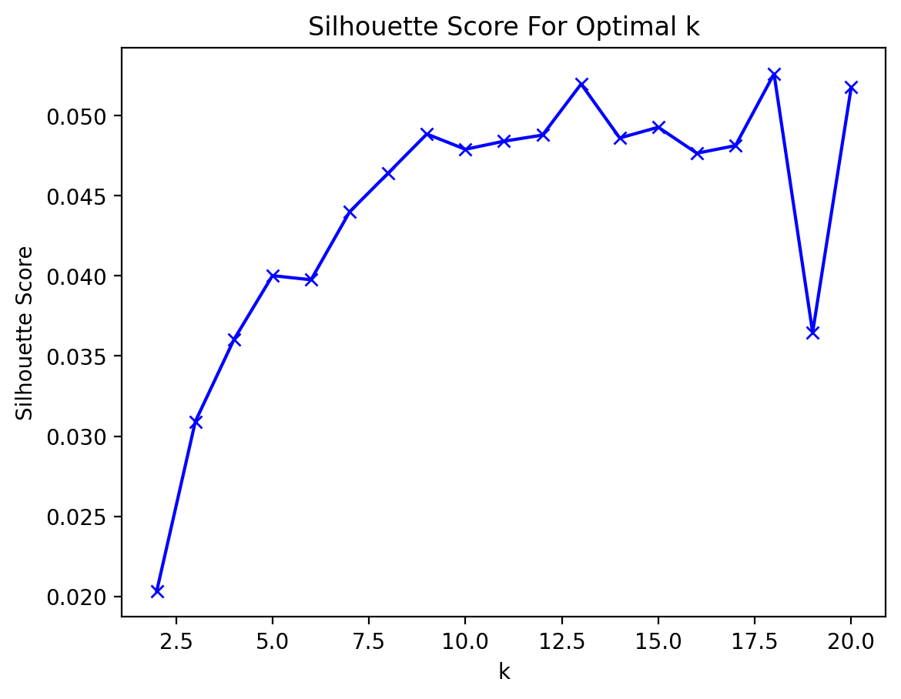
Towards a useful clustering of documents??
We chose a K-Value of 10 for our detailed analysis.
The Silhouette Scores indicate a very low confidence in the cluster assignment. This is confirmed by subsequent runs of our application often have different documents within the clusters.
10

Slide 11
K-Means Clustering data
Cluster Num | Num Docs | LowQual | Med Qual | HighQual | Avg Words | Predominant Words
1 | 54 | 2 | 37 | 15 | 839.61 | unclassified, will, soviet, people
2 | 27 | 2 | 25 | 0 | 288.07 | film, russian, cartoon, program
3 | 14 | 13 | 1 | 0 | 45.86 | object, large, meteor, light, observed
4 | 39 | 25 | 13 | 1 | 167.49 | object, reported, unidentified, sighting
5 | 44 | 31 | 12 | 1 | 146.20 | air, force, sighting, object, soviet
6 | 18 | 17 | 1 | 0 | 21.11 | dr, panel, air, project, subject
7 | 50 | 24 | 26 | 0 | 109.92 | Russian, serial, permission, incorrectly
8 | 46 | 3 | 37 | 6 | 809.46 | soviet, item, anon, meeting, russian
9 | 293 | 209 | 78 | 6 | 125.83 | unclassified, US, minister, will
10 | 33 | 33 | 0 | 0 | 17.91 | oil, tor, vas, tor, end air, lie, will, object
11

Slide 12
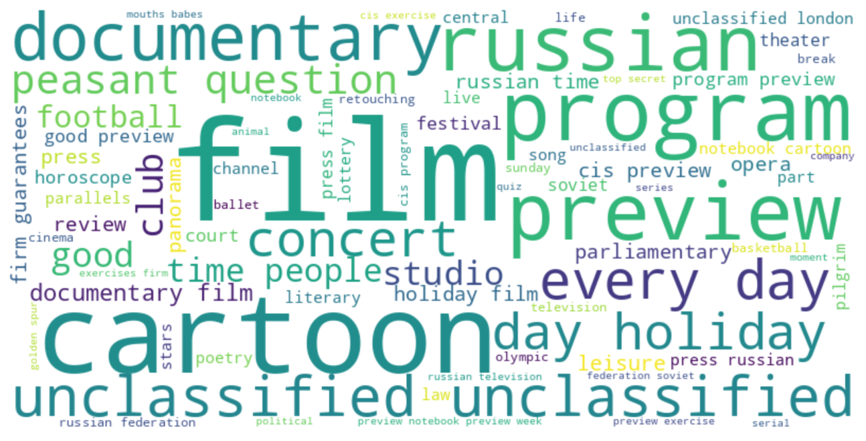
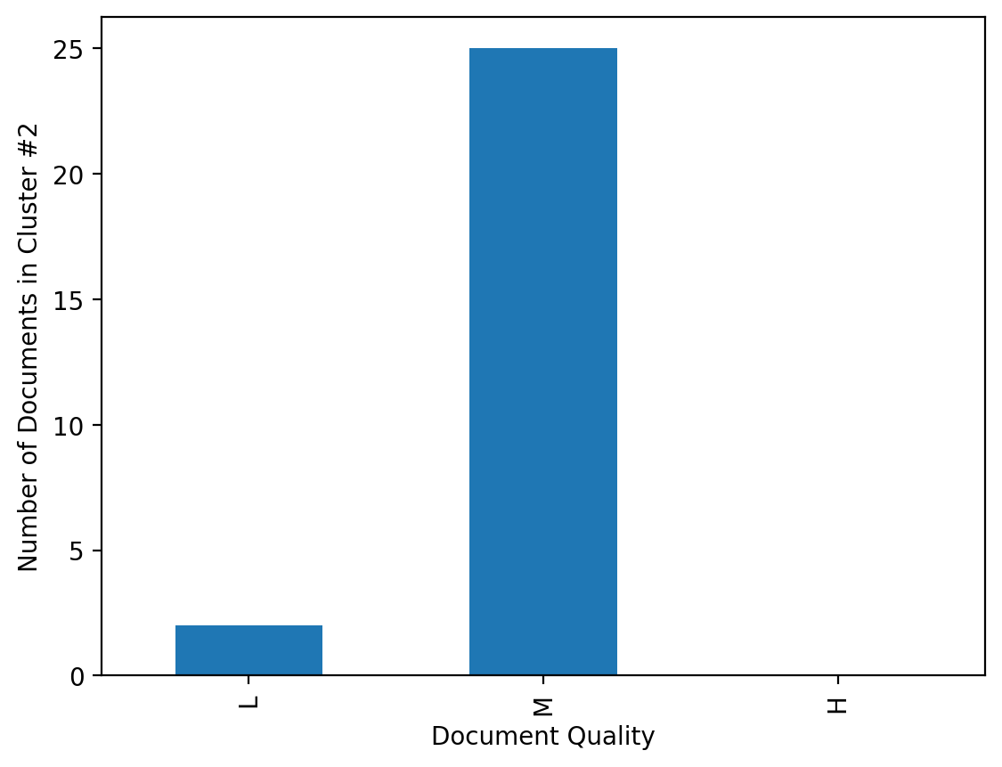
Clustering analysis
Clusters did not map to types of documents as cleanly as we hoped. There was variability in cluster content observed between runs, with a few exceptions:
One source of optimism was Cluster #2, which appeared consistently intact. All 27 PDFs of the cluster are transcripts of Russian TV programs.
Nearly all of the documents are about the same size and quality, which could have affected the cluster assignment more than content.
Almost all the “High Quality” documents were in a couple of clusters together, Clusters #1, 8, and 9. Cluster #10 was composed completely of short words. This could potentially be useful feature for binning in a software application.
Important predominate phrases were observed in multiple clusters (i.e., “Unclassified,” “Air,” and “Force.”). This might indicate low cohesiveness within a cluster or help identify words with little value for this use case.
12

Slide 13
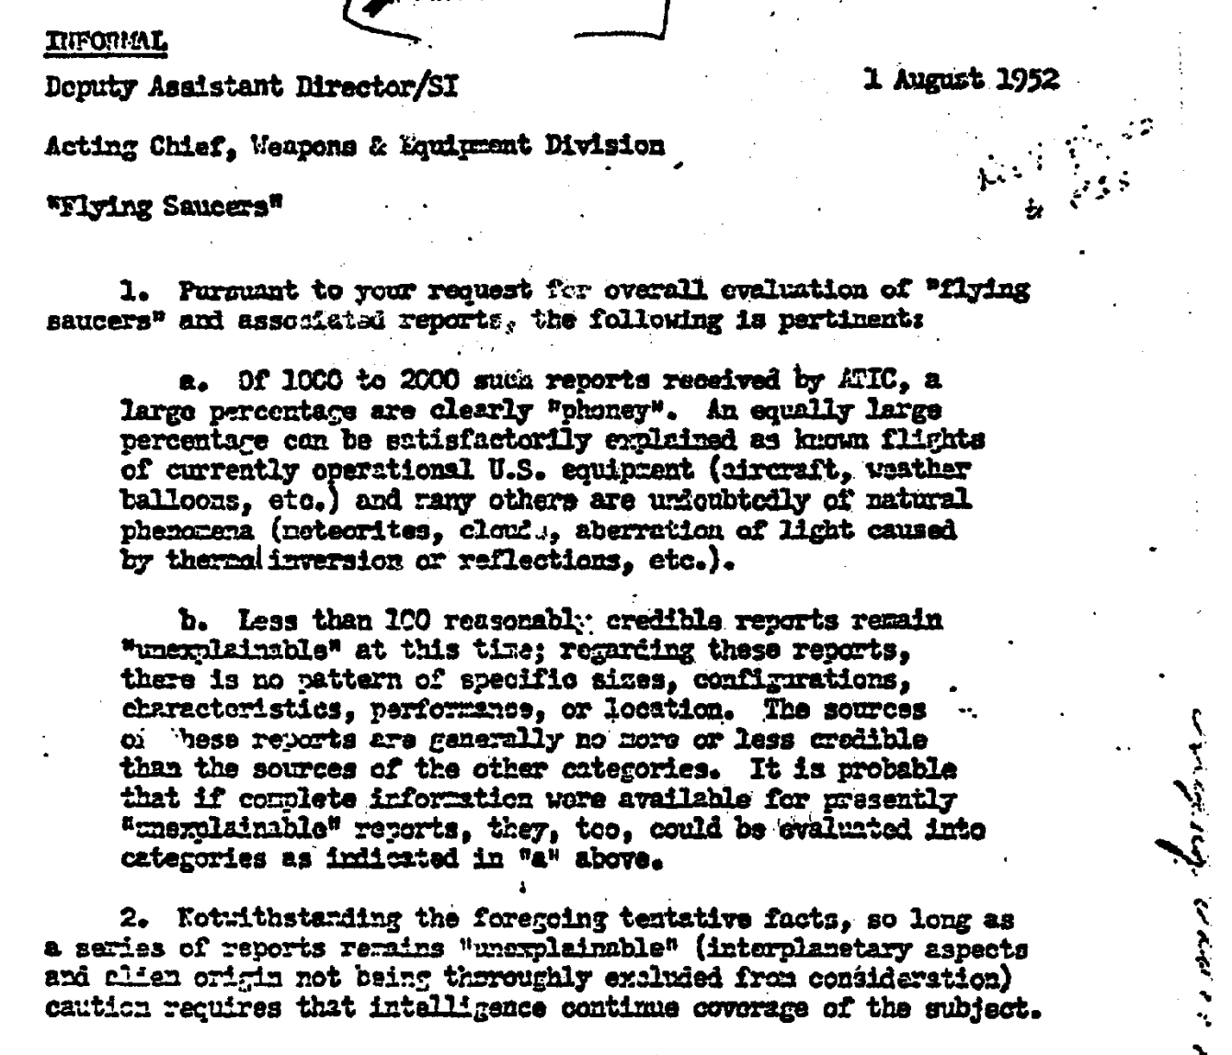
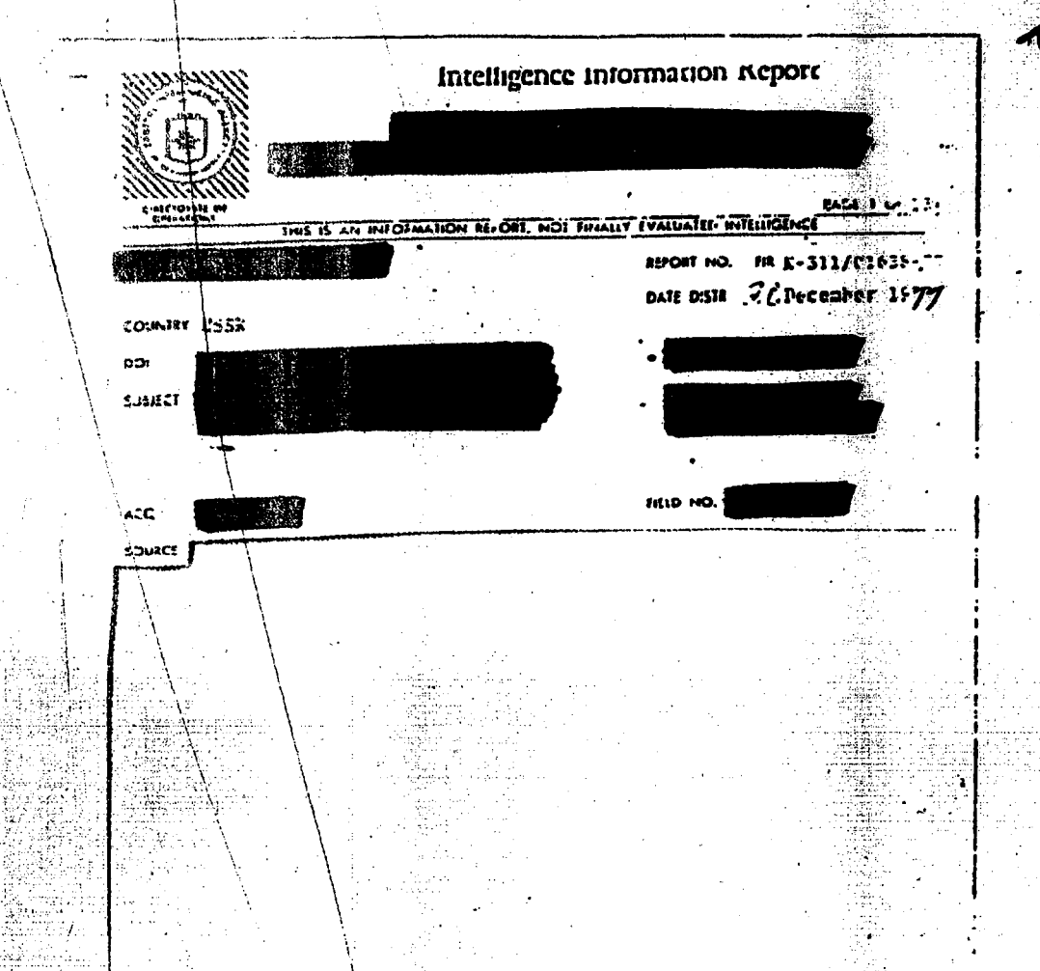
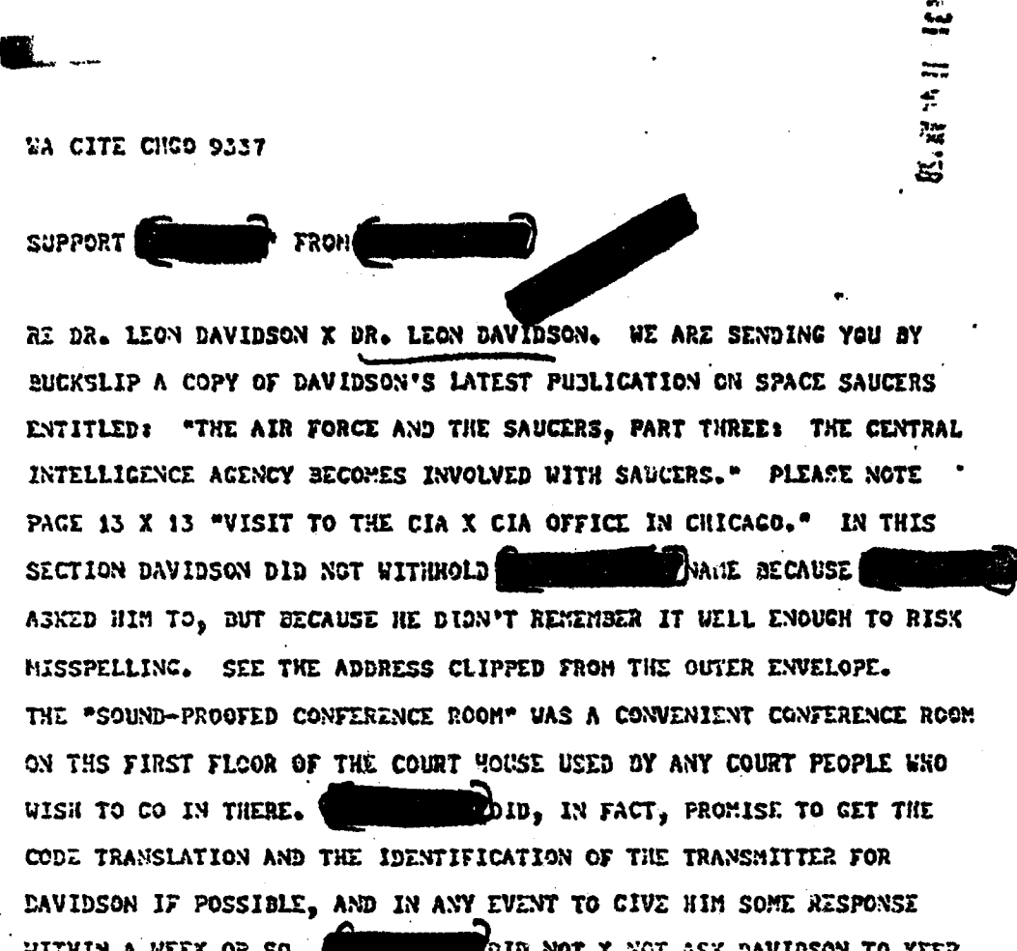
SOFTWARE ARCHITECTURE AND IMPLEMENTATION
Backend Data Subsystem
Data Processing Pipeline
PDF Converter
Feature
Vectorizer
Model Fitter
File System
Data
Conditioner
Data Processor
Model & Parameter
Admin
Specification of:
Cluster Size
Initialization Method
Iterations
Feature Extraction Method
doc3
Doc | Words
doc1 | [unclass,ufo,saucer,…]
doc2 | [intelligence,report,…]
doc3 | [weapons,equipment,…]
Cluster Data
doc2
doc1
…
Plots
Rendering
Display of:
Optimal Cluster Graph
K-Means Clusters
Word Cloud
Profile of Documents
Streamlit app
Visualization Subsystem
13

Slide 14



Software FEATURES
 | Process | Upload a set of PDF documents, track their progress through preprocessing, and view basic statistics on their contents.
 | Query | Pass a query string to the VSM and retrieve a specified number of results back from the index, along with the context in the document.
 | Explore | View statistics on SSE and Silhouette Scores for K-Values from 2-20, user can select one, and view cluster data as returned from K-Means algorithm.
14

Slide 15
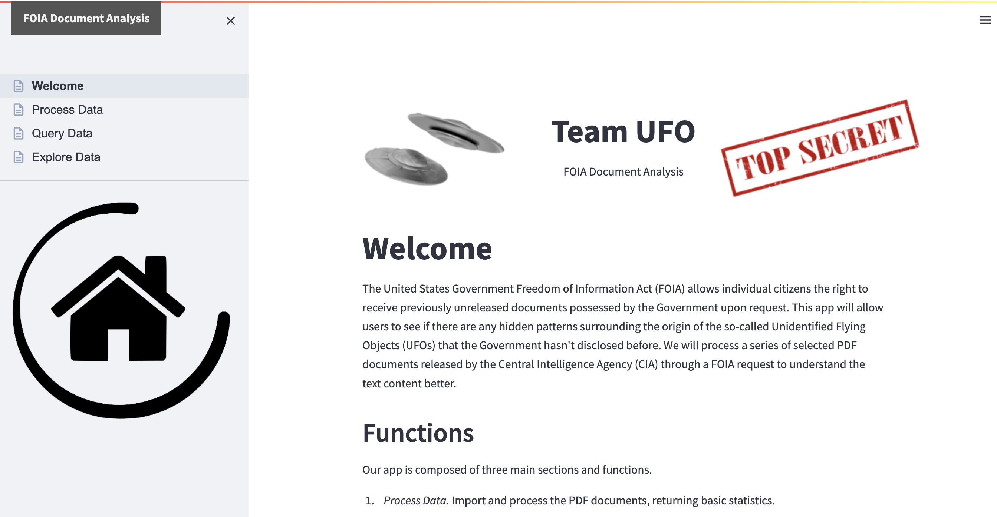
SOFTWARE DEMO
Our Python application, based upon a Streamlit application stack, is available on GitHub at: https://github.com/johnemyers/iste-612/
15

Slide 16
THANK YOU! QUESTIONS?
16

